Slide 1
When we Lost our Shine
Erica Heline, Meaghan Barrett, & Jacob McFadden

Slide 2
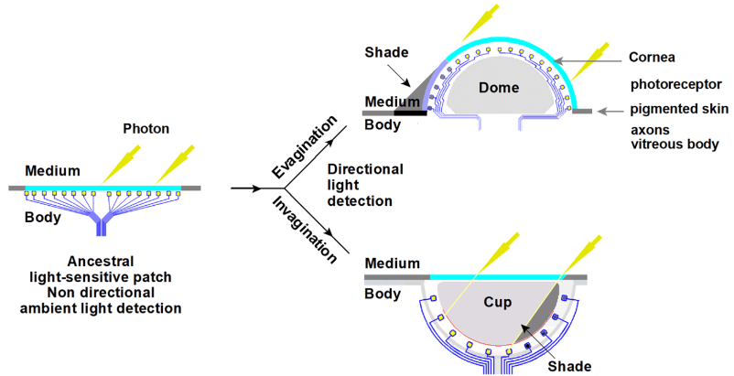
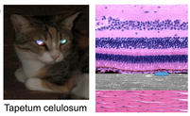
What Are We talking about?
Tapetum lucidum is a reflective layer of tissue behind the retina that reflects light back through the retina to improve night vision.
This creates the reflecting-eye effect that allows us to see them in the dark...and for them to see us.
Retina
RPE & CC
Choroid
Diagram of tapetum lucidum cellulosum found in carnivores including lower primates: retina, retinal pigment epithelium (RPE), choriocapillaris (CC), and choroid⁸.
Diagram of a verted and inverted retina¹

Slide 3
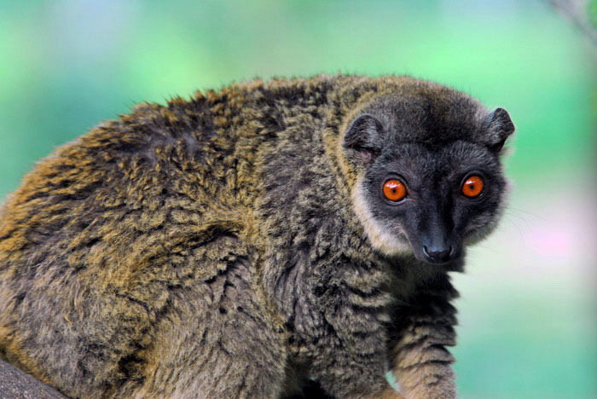
Why do scientists think we lose our lucidum?
Haplorhini became diurnal.
This is backed up by the fact that Eulemurs, diurnal Lemurs have also lost their lucidum⁵.
Selective pressure would require color-rich vision, requiring color vision and high acuity of which the tapetum would be in the way of^{13,17.}

Slide 4
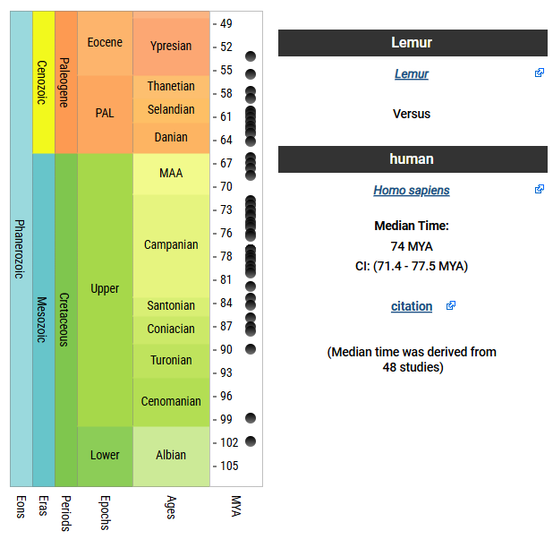
When Did We Lose it?
Time Tree divergence estimated between Homo sapiens (and other members of Haplorhini) and Lemurs (and other members of Strepsirrhini)⁵.

Slide 5
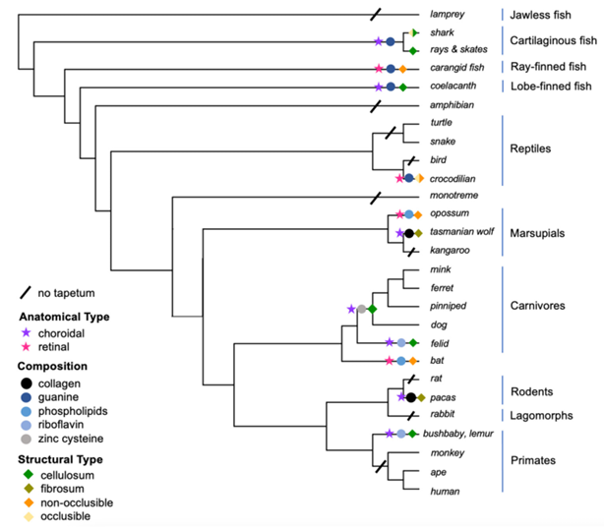
Where Did We Lose it?
Lemurs still have a riboflavin-based tapetum³ that is used to allow them to move in dim environments⁵.
Phylogenetic Tree Showing the presence of tapetum lucidum in various organisms³

Slide 6

Genes of Interest
G6PD – NADPH reduction^{11,12}.
IRBP – Retinoid transport between photoreceptors and retinal pigment epithelium^{9,10}.
MC1R – Pigment Regulation^{14,15}.
RAG2 – Immune system development^{14,16}.
Mitochondrial – DNA passed matrilineally without recombination^{7,18}.

Slide 7
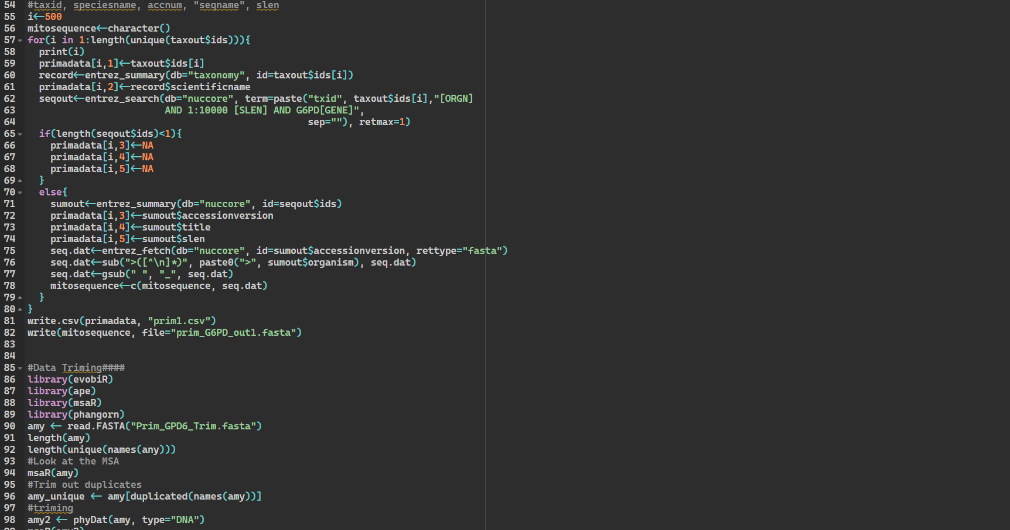
Methodology

Slide 8
Data Collection
Data Collection
Alignments
For collecting data for each of our genes (G6PD, RAG2, IRBP, MC1R, and Mitochondrial) we used the R program rentrez to collect primate DNA sequence data for each of our genes. Along with collecting DNA sequence data for our outgroup.
The R code we used can be found here: https://github.com/BARRETTMEAG/Lucidum/blob/main/1.%20Datasets/Dataset_template.R
After Collecting our DNA sequence data for each gene, we took those datasets and plugged them into MAFFT. This individually algin each of our data sets.

Slide 9
Trimming & Matrixes
Alignment Trimming
Matrix
To trim each of our alignments we used the R programs ape, msaR, and phangorn. After that was completed, we took that data and ran it through NG Phylogeny. This was done to ensure a correct alignment trimming.
Took our trimed alignments, plugged it into Liger (https://github.com/andrewbudge/Liger) through the computer terminal and used Python to dictate what to do. Edited the data in R to show the core data (used the programs ape, msaR, and Biostrings).
Then we examined the super matrix in AliView and deleted the taxa that showed little to no data. Reused Liger to only show the taxa that we wanted in AliView.

Slide 10
Bayesian Analysis & Tree Inference
Bayesian Analysis
Designing The Tree
With our matrix in hand, we did a Bayesian Analysis with it using BEAST2. The analysis was done with a chain length of 10 million. After the Bayesian analysis was done we put the results in the program Tracer to determine its ESS score.
Each tree has their own unique requirements.
To create a tree that showed the posterior values, there are many ways to go. With the help of Beauti and Beast and iqtree, the trees were formed.
Figtree allowed for viewing the trees. Selected posterior in both Appearance and node labels, allowed for the coloring of branches. This allowed to see the values and varying of color, depending on the tree.
In many of the trees, homo sapiens branch was longer than others.

Slide 11
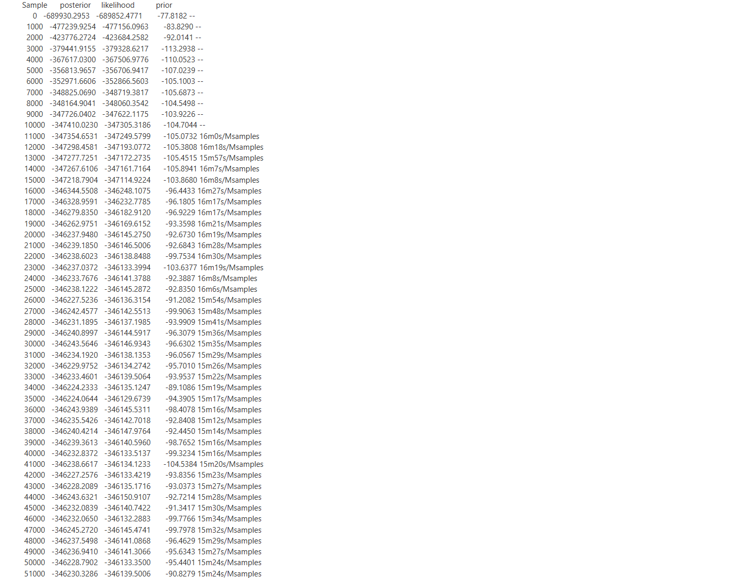
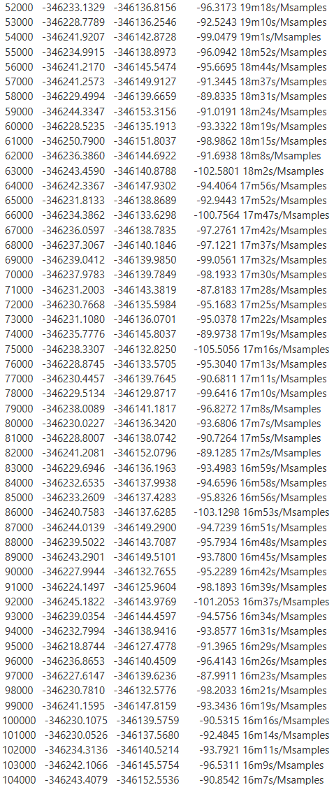
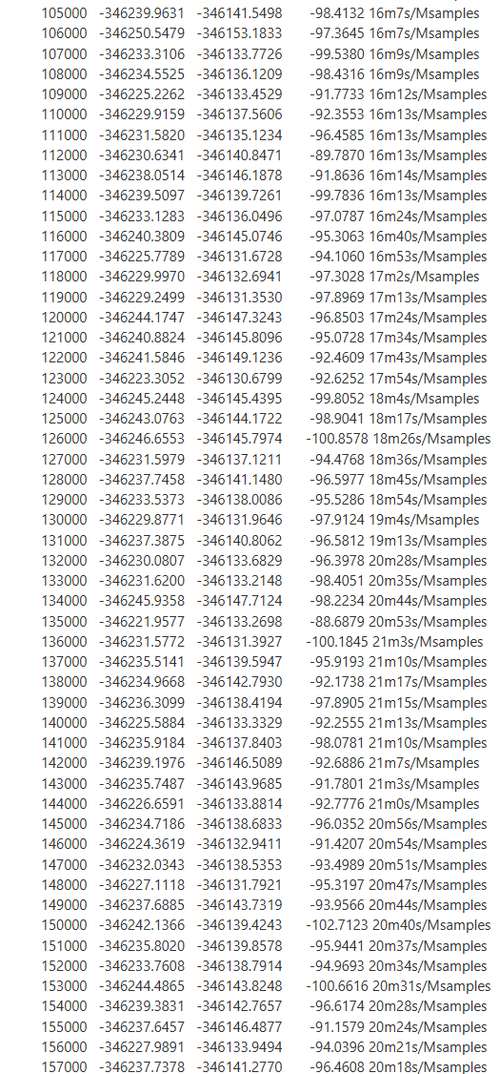
Results

Slide 12
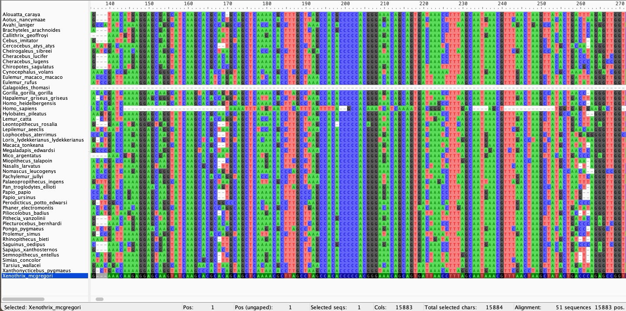
Super Matrix
Notes:
Shown here is our cut down 50 taxa super matrix

Slide 13
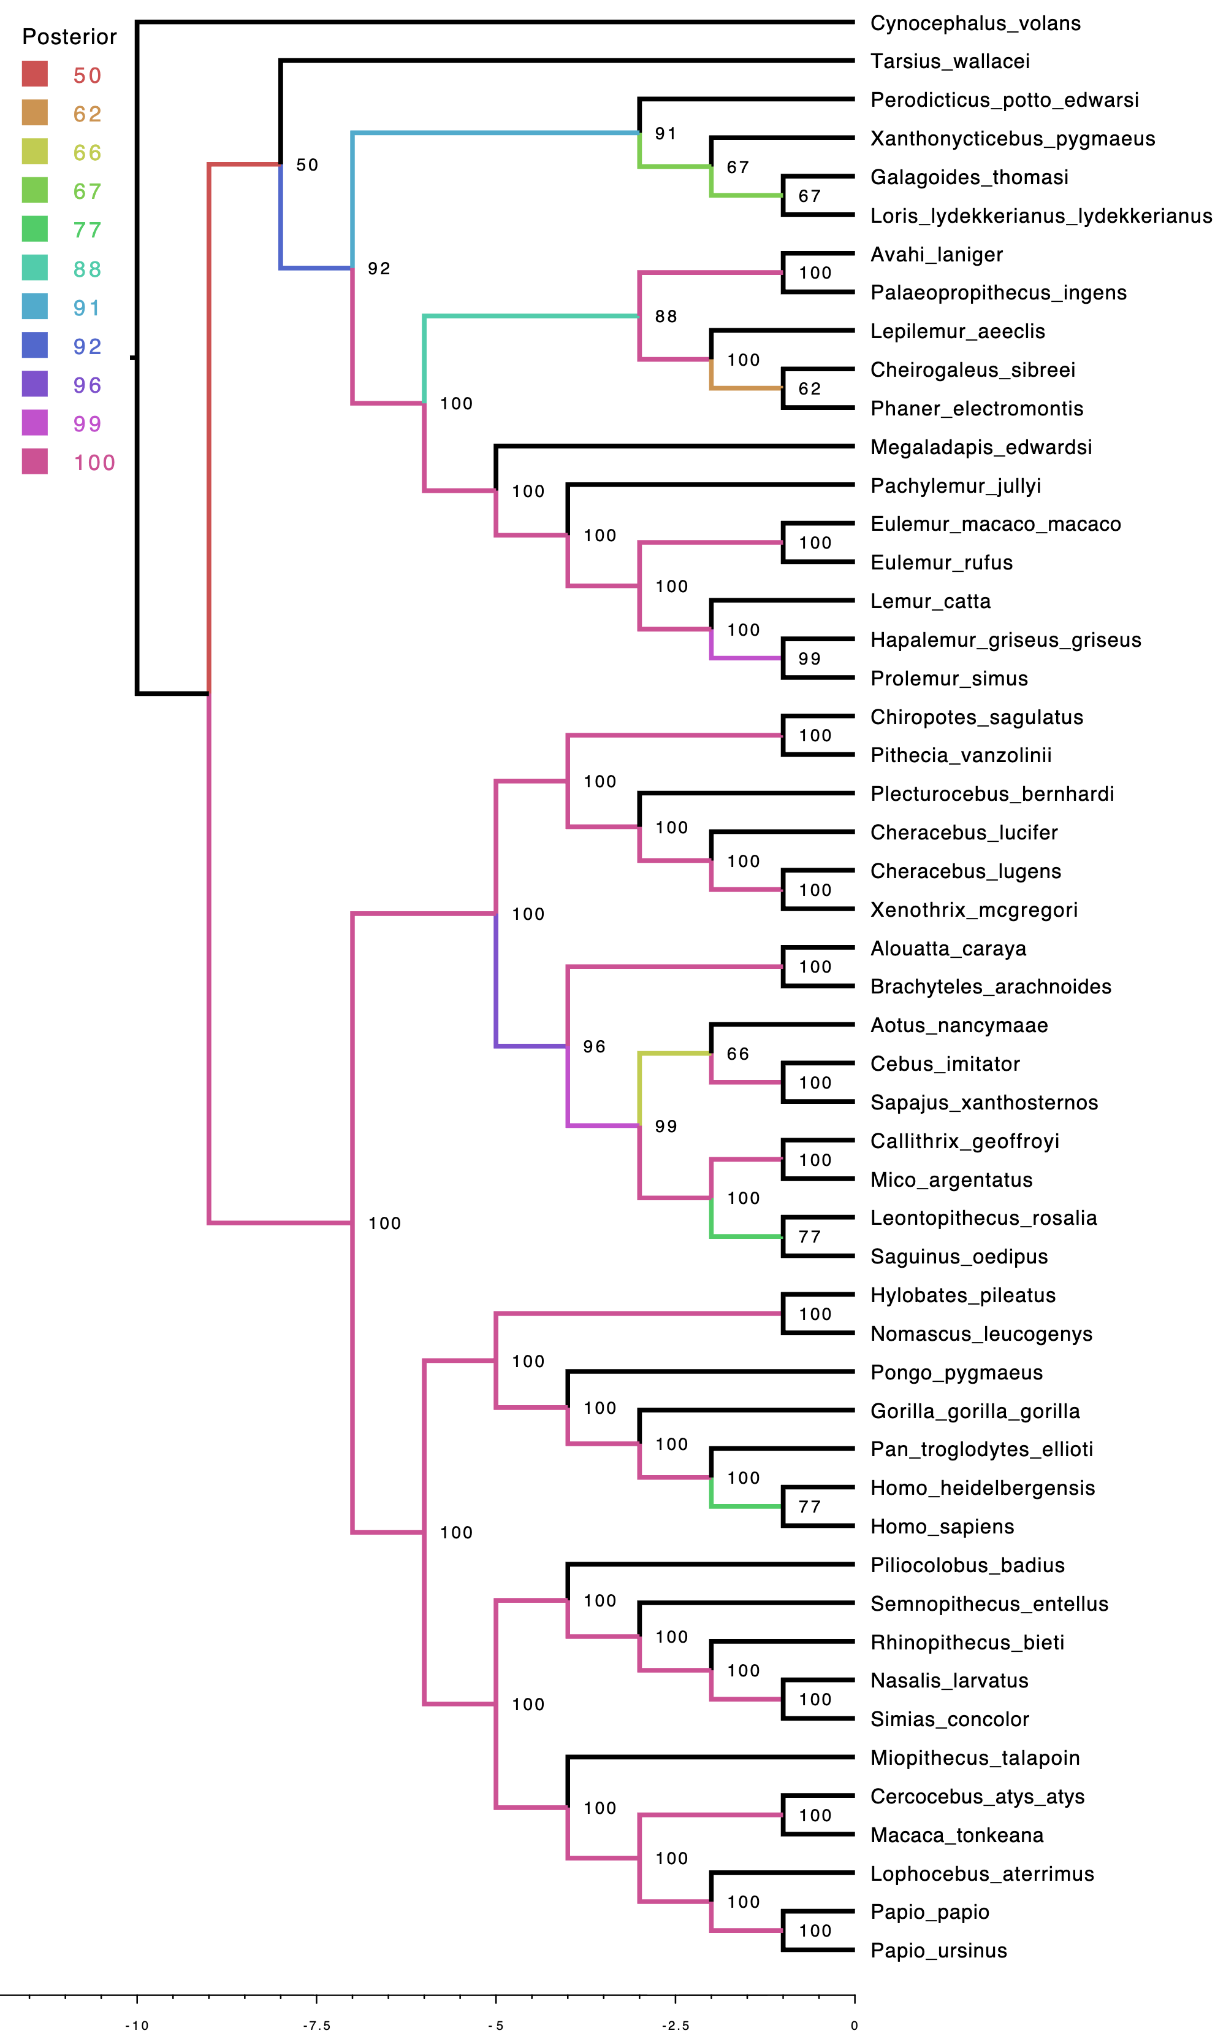
This shows the posterior values of our tree and its validity. As we all know not all trees are created equal.
Notes:
We confirmed that our alignments and supermatrix looked okay with limited gaps and a decent alignment, and yet we got a tree that is nothing like the one we were expecting with Homo sapiens being unrelated to the Homo heidelbergensis and Pan troglodytes in the BL tree.

Slide 14
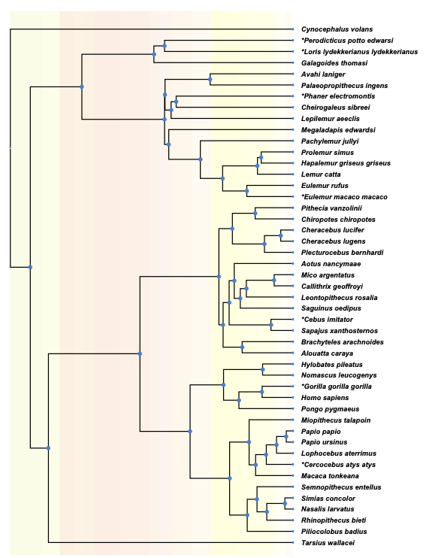
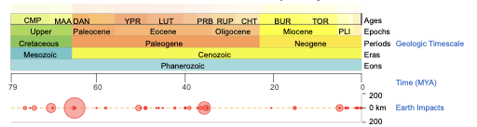
Lucidum
No Lucidum
Unknown
TimeTree
Notes:
This shows roughly about the time that we lost our lucidum, we use TimeTree

Slide 15
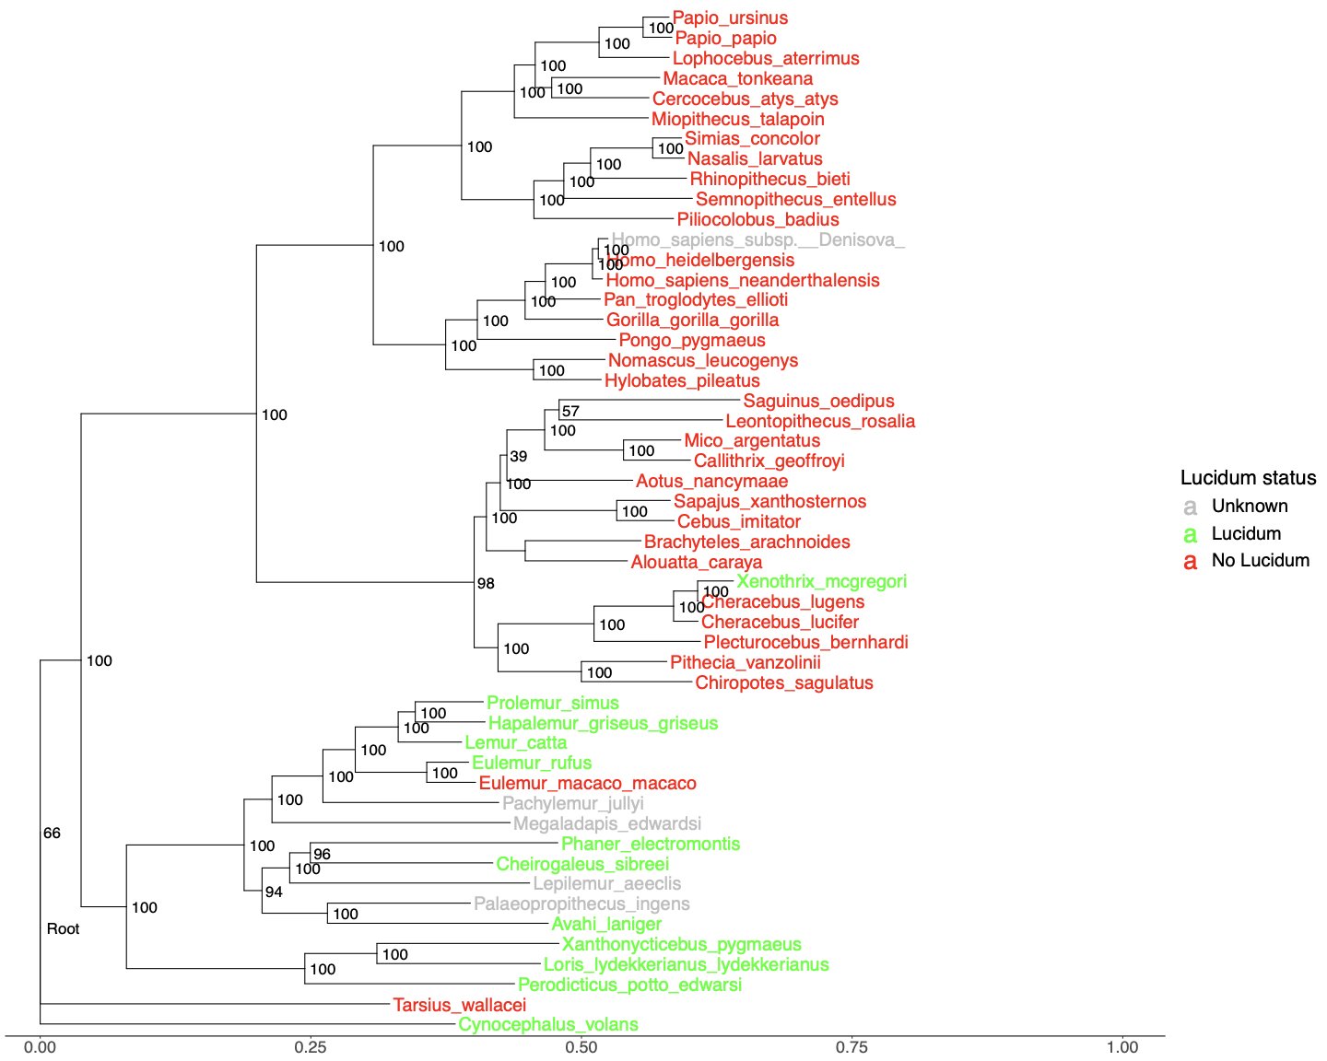

Slide 16
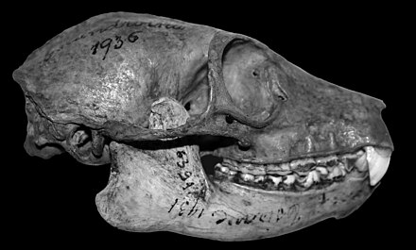
Discussion
From our results we can tell that a split ~75 million years ago was the start of primates losing their lucidum. This split may be when lemurs diverge from other primates. Based on figure 3, where nearly all lemurs have their lucidum, and are on one side of this split 75 mya.
Eulemur macaco macaco and Tarslurs wallacel mutated to not have a lucidum. Xenothrix mcgregori on the otherhand mutated to have a lucidum

Slide 17
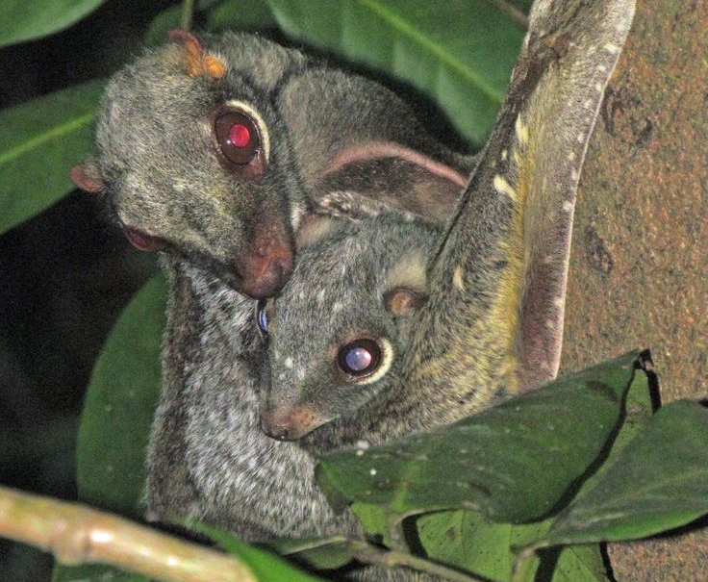
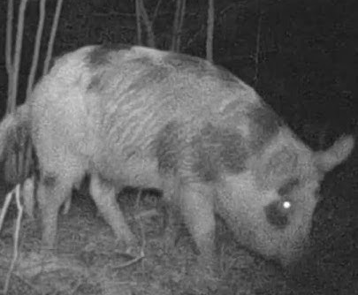
Future Direction
Expand our list of taxa outside of primates.
Such as Dermoptera (flying lemures) and pigs.
Looking at T2T genomes of other primates, which could give more conclusive results.
Try again with sets of genes used in other works to more accurate trees like those in Matsui and Hasegawa's 2012 review¹⁹ before then moving on to genes related to the lucidum and what remains of them in non-lucidum species.
Notes:
Mention that we don’t know the actual gene responsible for the lucidum

Slide 18
References -
1. Oomens, J.M.M. A possible origin of the inverted vertebrate retina revealed by physical modeling. J Biol Phys 50, 327–349 (2024). https://doi.org/10.1007/s10867-024-09662-6
2. Sudhir Kumar, Glen Stecher, Michael Suleski, S. Blair Hedges, TimeTree: A Resource for Timelines, Timetrees, and Divergence Times, Molecular Biology and Evolution, Volume 34, Issue 7, July 2017, Pages 1812–1819, https://doi.org/10.1093/molbev/msx116
3. Vee, S., G. Barclay, and N.H. Lents. 2022. The glow of the night: The tapetum lucidum as a co-adaptation for the inverted retina. BioEssays 44(10): e2200003
4. Newman, B. A., & Hammond, B. R. (2025). Potential Spectral Tuning of the Tapetum Lucidum in a Broadly Distributed Ungulate. Journal of Experimental Zoology Part A: Ecological and Integrative Physiology, 343(8), 905-910. https://doi.org/10.1002/jez.70007
5. Schapker, N. M. (2025). Primate assessment of risk during arboreal locomotion (Doctoral dissertation, Kent State University)
6. Schwab, Ivan R et al. “Evolution of the tapetum.” Transactions of the American Ophthalmological Society vol. 100 (2002): 187-99; discussion 199-200.
7. Finnegan, N., M. Lima, M. G., & Lynch, J. W. (2025). Mitochondrial DNA for Phylogeny Building: Assessing Individual and Grouped mtGenes as Proxies for the mtGenome in Platyrrhines. American Journal of Primatology, 87(3), e70017. https://doi.org/10.1002/ajp.70017
8. Zueva, L., Zayas-Santiago, A., Rojas, L., Sanabria, P., Alves, J., Tsytsarev, V., & Inyushin, M. (2022). Multilayer subwavelength gratings or sandwiches with periodic structure shape light reflection in the tapetum lucidum of taxonomically diverse vertebrate animals. Journal of Biophotonics, 15(6), e202200002. https://doi.org/10.1002/jbio.202200002
9. Poux, C., & Douzery, J. P. (2004). Primate phylogeny, evolutionary rate variations, and divergence times: A contribution from the nuclear gene IRBP. American Journal of Physical Anthropology, 124(1), 01-16. https://doi.org/10.1002/ajpa.10322
10. Zeng, S., Zhang, T., Madigan, M. C., Fernando, N., Zhou, F., Pierce, M., Chen, Y., Huang, L., Natoli, R., Gillies, M. C., & Zhu, L. (2020). Interphotoreceptor Retinoid-Binding Protein (IRBP) in Retinal Health and Disease. Frontiers in Cellular Neuroscience, 14, 577935. https://doi.org/10.3389/fncel.2020.577935

Slide 19
References (continued) -
11. Von Dornum, M., & Ruvolo, M. (1999). Phylogenetic Relationships of the New World Monkeys (Primates, Platyrrhini) Based on Nuclear G6PD DNA Sequences. Molecular Phylogenetics and Evolution, 11(3), 459-476. https://doi.org/10.1006/mpev.1998.0582
12. Tang, B. L. (2019). Neuroprotection by glucose-6-phosphate dehydrogenase and the pentose phosphate pathway. Journal of Cellular Biochemistry, 120(9), 14285-14295. https://doi.org/10.1002/jcb.29004
13. Ollivier, F. J., Samuelson, D. A., Brooks, D. E., Lewis, P. A., Kallberg, M. E., & Komáromy, A. M. (2004). Comparative morphology of the tapetum lucidum (among selected species). Veterinary Ophthalmology, 7(1), 11-22. https://doi.org/10.1111/j.1463-5224.2004.00318.x
14. Munds, R. A., Titus, C. L., Eggert, L. S., & Blomquist, G. E. (2018). Using a multi-gene approach to infer the complicated phylogeny and evolutionary history of lorises (Order Primates: Family Lorisidae). Molecular Phylogenetics and Evolution, 127, 556-567. https://doi.org/10.1016/j.ympev.2018.05.025
15. Wolf Horrell, E. M., Boulanger, M. C., & A., J. (2016). Melanocortin 1 Receptor: Structure, Function, and Regulation. Frontiers in Genetics, 7, 187214. https://doi.org/10.3389/fgene.2016.00095
16. Chen, X., Yao, L., Li, W., Ma, S., Yuan, X., Yang, Y., Yuan, Y., Liu, Y., Liu, L., Wang, H., Gellert, M., & Yang, W. (2025). How RAG1/2 evolved from ancestral transposases to initiate V(D)J recombination without transposition. Proceedings of the National Academy of Sciences, 122(31), e2512362122. https://doi.org/10.1073/pnas.2512362122
Reviews -
17. Regan B. C., Julliot C., Simmen B., Viénot F., Charles–Dominique P. and Mollon J. D. 2001 Fruits, foliage and the evolution of primate colour visionPhil. Trans. R. Soc. Lond. B356229–283 http://doi.org/10.1098/rstb.2000.0773
18. Ferreira, T., & Rodriguez, S. (2024). Mitochondrial DNA: Inherent Complexities Relevant to Genetic Analyses. Genes, 15(5), 617. https://doi.org/10.3390/genes15050617
19. Matsui, A., Hasegawa, M. (2012). Molecular Phylogeny and Evolution in Primates. In: Hirai, H., Imai, H., Go, Y. (eds) Post-Genome Biology of Primates. Primatology Monographs. Springer, Tokyo. https://doi.org/10.1007/978-4-431-54011-3_16

Slide 20

Special Thanks
Andrew Budge for helping with the super matrix and directing us to his program Liger (https://github.com/andrewbudge/Liger).
Dr. Odgen & Dr. Hjelmen for their guidance.

Slide 21
Ask Us Questions

